Slide 1
Data Modelling Concepts
software requirements include the need to create, extend, or interface with a database or if complex data structures must be constructed and manipulated, the software team may choose to create a data model.
A software engineer or analyst defines all data objects, the relationships between the data objects, and other information that is related to the relationships.
The entity-relationship diagram (ERD) addresses these issues and represents all data objects that are entered, stored, transformed, and produced within an application.
Data object
Data Attribute
Relationship

Slide 2
Data object:
representation of composite information that must be understood by software.
composite information means something that has a number of different properties or attributes.
Ex. Dimension
A data object can be an external entity, a thing (e.g., a report or a display), an occurrence (e.g., a telephone call) or event (e.g., an alarm), a role (e.g., salesperson), an organizational unit (e.g., accounting department), a place (e.g., a warehouse), or a structure (e.g., a file).
Ex. Person , car
The description of the data object incorporates the data object and all of its attributes.
A data object encapsulates data only—there is no reference within a data object to operations that act on the data.

Slide 3
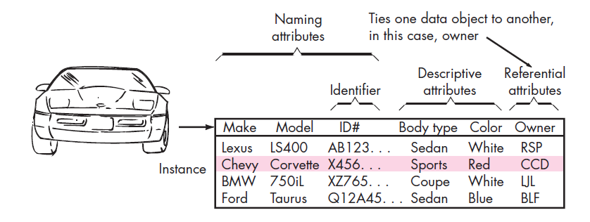

Slide 4
Data Attribute:
Data attributes define the properties of a data object and take on one of three different characteristics.
They can be used to
name an instance of the data object,
describe the instance,
or (3) make reference to another instance in another table.
In addition, one or more of the attributes must be defined as an identifier—that is, the identifier attribute becomes a “key” when we want to find an instance of the data object
The set of attributes that is appropriate for a given data object is determined through an understanding of the problem context.
Data Objects and Object-Oriented Classes—Are They the Same Thing?
Ans.

Slide 5
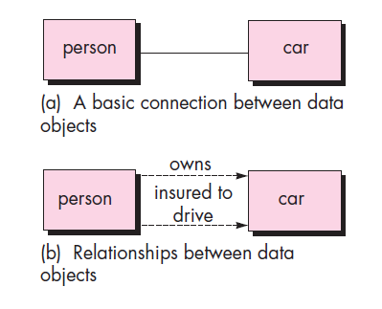
Relationships:
Data objects are connected to one another in different ways. ex. Car and person
determine the answer, you should understand the role of people (owners, in this case) and
cars within the context of
the software to be built.

Slide 6
Behavioral Modeling

Slide 7
Creating a Behavioral Model
Identify events found within the use cases and implied by the attributes in the class diagrams
Build a state diagram for each class, and if useful, for the whole software system
<number>

Slide 8
Building a State Diagram
A state is represented by a rounded rectangle
A transition (i.e., event) is represented by a labeled arrow leading from one state to another
Syntax: trigger-signature [guard]/activity
The active state of an object indicates the current overall status of the object as is goes through transformation or processing
A state name represents one of the possible active states of an object
The passive state of an object is the current value of all of an object's attributes
A guard in a transition may contain the checking of the passive state of an object
<number>

Slide 9
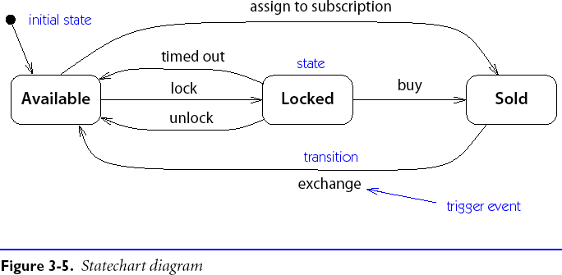
Statechart Diagrams

Slide 10
Statechart Diagram Notation
A Statechart Diagram describes the temporal evolution of an object of a given class in response to interactions with other objects inside or outside the system.
An event is a one-way (asynchronous) communication from one object to another:
atomic (non-interruptible)
includes events from hardware and real-world objects e.g., message receipt, input event, elapsed time, ...
notation: eventName(parameter: type, ...)
may cause object to make a transition between states

Slide 11
Statechart Diagram Notation ...
A state is a period of time during which an object is waiting for an event to occur:
depicted as rounded box with (up to) three sections:
name — optional
state variables — name: type = value (valid only for that state)
triggered operations — internal transitions and ongoing operations
may be nested

Slide 12
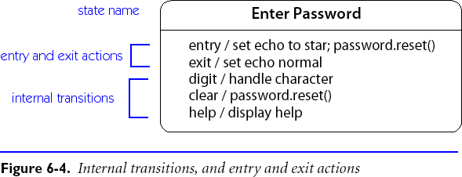
State Box with Regions
The entry event occurs whenever a transition is made into this state, and the exit operation is triggered when a transition is made out of this state.
The help and character events cause internal transitions with no change of state, so the entry and exit operations are not performed.

Slide 13
Transitions
A transition is an response to an external event received by an object in a given state
May invoke an operation, and cause the object to change state
May send an event to an external object
Transition syntax (each part is optional):
event(arguments) [condition]
/ ^target.sendEvent operation(arguments)
External transitions label arcs between states
Internal transitions are part of the triggered operations of a state

Slide 14
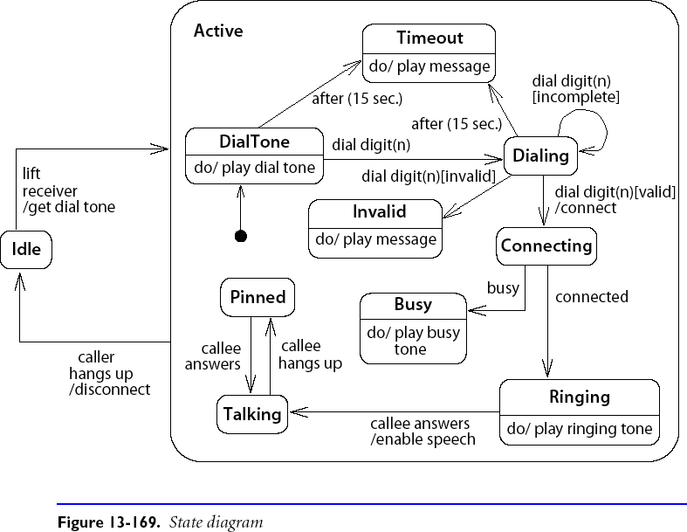
Nested Statecharts

Slide 15
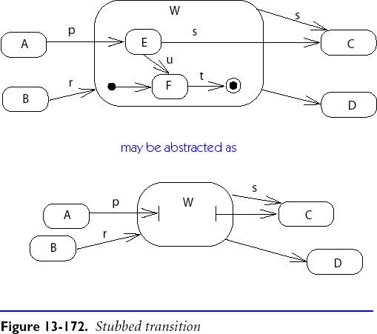
Composite States
Composite states may depicted either as high-level or low-level views.
“Stubbed transitions” indicate the presence of internal states:
Initial and terminal substates are shown as black spots and “bulls-eyes”

Slide 16
Creating Data Flow Diagrams

Slide 17

Data Flow Diagrams Symbols
DeMarco & Yourdon
System Analysis and Design
System – a group of interrelated procedures used for a business function, with an identifiable boundary, working together for some purpose.
Source/ Sink
Analysis – separation of a whole into its component parts
0.0
Process
Design – to create, fashion, execute, or construct according to plan
DATA STORE
Physical Data Flow Diagrams – show how the current system flows
Logical Data Flow Diagrams – show the data flow, structure, and requirements of a new system
Data Flow Lines

Slide 18
Data Flow Diagrams Symbols
DeMarco & Yourdon
Source/Sink – help to establish the boundaries of the system. A source identifies the origin of data inflow to the system. A sink identifies the outflow of a system, many times as information.
Sometimes referred to an entity, a source may be a customer, vendor, employee, or even another system. A single entity can be both a source and a sink.
Source/ Sink
0.0
Process
DATA STORE
Data Flow Lines

Slide 19
Data Flow Diagrams Symbols
DeMarco & Yourdon
Processes – are the activities (manual and automated) that transform the inputs, transport data from process to process, stores the data, and produce the outputs of a system.
Processes are used on every DFD starting with an over all process on the context level diagram, the system. The system is then decomposed until a primitive level is obtained. The primitive level is the point in which the relevant activities of a process are identified.
Source/ Sink
0.0
Process
DATA STORE
Data Flow Lines

Slide 20
Data Flow Diagrams Symbols
DeMarco & Yourdon
Data Store – is the resting place of the data in a system. A data store can be in the form of paper, a disk file or any other media.
Normally the word ‘data’ does not appear in the title of a data store. Some examples of data stores are Customer Order, Payment, Invoice, Time Card……
Source/ Sink
0.0
Process
DATA STORE
Data Flow Lines

Slide 21
Data Flow Diagrams Symbols
DeMarco & Yourdon
Data Flow – is the data in motion. Data can move from the outside (source) into a process. Once the inside of a system data must flow from place to place through a process, the flow lines show this movement.
The lines are labeled to provide clarity and meaning to the data moving through the system.
Source/ Sink
0.0
Process
DATA STORE
Data Flow Lines

Slide 22
Data Flow Diagrams Levels
DeMarco & Yourdon
Context Level DFD
Source/ Sink
Source/ Sink
0.0
Process
Source/ Sink
Data Flow
Data Flow
Data Flow
Level 0 DFD
0.0
Process
1.0
Process
Data Flow
Data Flow
Data Flow
DATA STORE
Source/ Sink
2.0
Process
Source/ Sink
Data Flow
Data Flow
Data Flow Lines
Data Flow
3.0
Process
Data Flow

Slide 23
Data Flow Diagrams Levels
DeMarco & Yourdon
Source
Level 1 DFD (and on)
Source/ Sink
Data Flow
1.1
Process
DATA STORE
0.0
Process
Source
1.2
Process
Data Flow
DATA STORE
Data Flow
Data Flow Lines
Sink

Slide 24
Data Flow Diagrams Levels

Slide 25
Creating Data Flow Diagrams
Steps:
Create a list of activities
Construct Context Level DFD (identifies sources and sink)
Construct Level 0 DFD (identifies manageable sub process )
Construct Level 1- n DFD (identifies actual data flows and data stores )

